Slide 1
Dependent-Samples t-Test
Analyzing Two-sample
Matched-Groups and
Within-Subjects Designs

Slide 2
Comparison of Between-Subjects Designs: Independent and Matched Samples
Independent Samples Design
Different groups of participants receive different levels of the IV
Each participant serves in only one condition
Independent samples are used in each condition
Participants are selected without regard to who is in the other condition
Matched Samples Design
Different groups of participants receive different levels of the IV
Each participant serves in only one condition
Dependent samples are used in each condition
Participants are matched to someone in the other condition on variable(s) correlated with the DV
Notes:
In the peppermint and digit span experiment, one group ate a peppermint and one group didn’t, prior to completing the task.
In the ball toss experiment, we matched participants on height.
What were the similarities between the design of the two experiments?
How do they differ?
In both experiments:
Different groups of participants received different levels of the IV
(0 or 1 peppermint; standing on one or two feet)
Each participant served in only one of the two levels of the IV
In the peppermint and digit span experiment, we randomly assigned participants to their conditions, so the samples were independent, which means that who is in one group does not depend on who is in the other group.
In the ball toss experiment, we matched participants on height, so the samples were dependent. We matched on height because we supposed that height would be correlated with the outcome measure (the number of baskets made), and by matching, we could ensure that height was balanced between the two groups.

Slide 3
Comparison of Between-Subjects and Within-Subjects Design
Between-Subjects Design
Different groups of participants receive different levels of the IV
Each participant serves in only one condition of the IV
Independent or matched samples are used in each condition
Within-Subjects Design
One group of participants receives every level of the IV
Each participant serves in all conditions of the IV
The same sample is used in each condition
Notes:
Unlike the ball toss experiment, in the chocolate and letter cancelling experiment, there was just one group of participants, all of whom received every level of the IV (0 and 1 piece of chocolate). In these studies, each participant served in all conditions of the IV, so it was the same sample of people who served in each condition.

Slide 4
Appropriate Statistics?
Independent-Samples Design ➔
independent-samples t test
Matched-Groups Design ➔
dependent-samples t test
Within-Subjects Design ➔
dependent-samples t test
Notes:
Sometimes you will see the independent samples design referred to as the between subjects design, but this ignores the fact that matched groups is also a between subjects design.
What is called a dependent samples t test here is called a paired samples t test in SPSS.

Slide 5
Dependent-Samples t Tests
Notes:
To test for differences in scores when using a matched-subjects or repeated-measures design, we use the dependent-samples t test.
When we have dependent samples, scores on the DV are likely to be more similar for each member of a pair due to the similarity between members of the pair on whatever variable(s) they were matched on.
So a score in one condition of the IV is paired with a score in another condition of the IV, and the scores are NOT analyzed independent of one another.

Slide 6
Independent-Sample Dependent-Samples t-Test t-Test
Randomly selected samples
DV normally distributed
DV measured using ratio or interval scale
Homogeneity of variance
Randomly selected samples
DV normally distributed
DV measured using ratio or interval scale
Homogeneity of variance
Requires dependent samples (and equal n’s)
Notes:
Same requirements as for the independent-samples t test except:
Requires dependent samples
So they must be:
matched on some variable
Come from a naturally occurring pair (i.e., twins) OR
Be repeated measures (within-subjects)
Since you have to have pairs, there must be equal sample sizes (N)

Slide 7
General Model for z-Test and Single-Sample t-Test
Original
Population
Sample
H₀
Treated
Population
H_{A}
Notes:
Recall that for a z-test or a single-sample t-test, we are trying to determine if the sample represents the original population or if it represents the treated population

Slide 8
General Model for
Independent-Samples t-Test
Population A
(Control/
Original)
Sample A
H₀
Population B
(Experimental/
Treated)
Sample B
H₀: μ₁ - μ₂ = 0
Notes:
For an independent-samples t test, we are trying to determine if the 2 samples represent one (the same) population or 2 different populations
The null hypothesis says that they come from one population
So there’s no difference between their means
It is written as H₀: μ₁ - μ₂ = 0

Slide 9
General Model for
Independent-Samples t-Test
Population A
(Control/
Original)
Sample A
H_{A}
Population B
(Experimental/
Treated)
Sample B
H_{A}: μ₁ - μ₂ ≠ 0
Notes:
The alternative hypothesis says that they come from 2 different populations
That their means differ from one another
It is written as H_{A}: μ₁ - μ₂ ≠ 0

Slide 10

General Model for
Dependent-Samples t-Test
Independent-Samples t-Test:
compare the mean of Group 1 with the mean of Group
2 to determine if they are equal (H₀) or different (H_{A})
Dependent-Samples t-Test:
1. find the difference for each pair of scores (D = X₁ – X₂)
2. calculate the mean of the difference
3. determine if the mean difference differs from 0
Notes:
In the independent-samples t test, we compared the mean of Group 1 with the mean of Group 2
If they were equal (which is what the null hypothesis states), they come from the same population
If they were not equal (which is what the alternative hypothesis states), they represent 2 different populations
Again, in the independent-samples t-test, we compared the mean of group 1 with the mean of group 2 to determine if there is a difference
But if we did the same thing for our 2 sets of scores for our dependent groups, we would lose the connection between pairs of scores, and we established that connection for a reason, so we don’t want that to happen.
1. So we have to first find the difference for each pair of scores
2. And then calculate the mean of that group of difference scores
3. Finally, we compare that mean difference to 0 to see if it is significantly different from 0

Slide 11
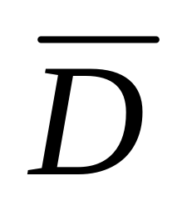
General Model for
Dependent-Samples t-Test
Difference Scores
of Population A
(Control/
Original)
H₀: μ_{D} = 0
Difference Scores
of Population B
(Experimental/
Treated)
H_{A} : μ_{D} ≠ 0
Notes:
For a dependent-samples t test, we are trying to determine if the before treatment and after treatment scores differ from one another (or for matched samples, if the group who received treatment and those who did not receive treatment differ from one another)
The null hypothesis says that they do not differ from one another
The IV did not have an effect on the DV
So their difference equals 0
It is written as H₀: μ_{D} = 0
The idea behind the null hypothesis equaling 0 is that:
Before score minus after score may be positive sometimes
Before score minus after score may be negative sometimes
But they average out to 0 because the IV is not having a consistently positive (or negative) effect; it’s having an unsystematic effect
The alternative hypothesis says that they do differ from one another
The IV does have an effect on the DV
So their difference does not equal 0 (because the before score minus the after score is more often going to be positive, or is more often going to be negative)
It is written as H₀: μ_{D} ≠ 0
The idea here is that the IV is having a systematic effect on the DV

Slide 12
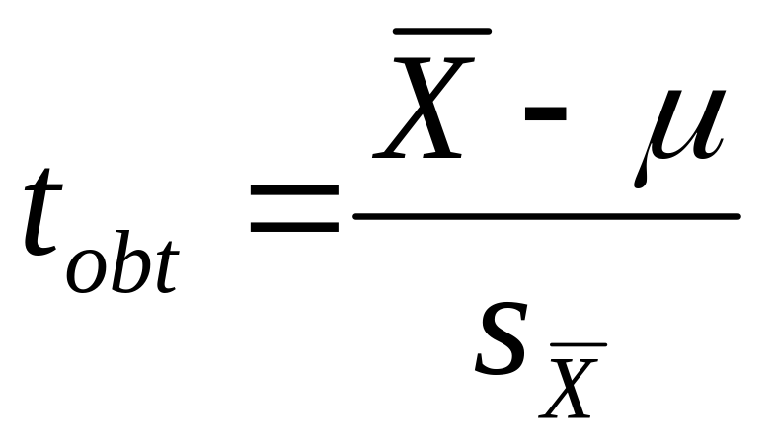
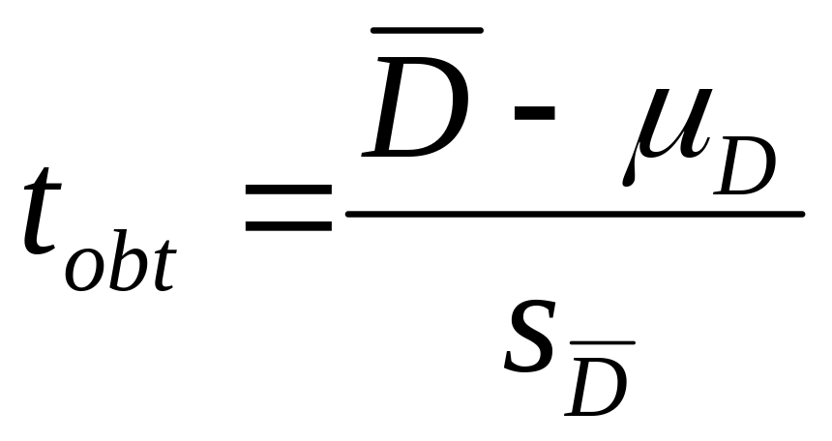
Definitional Formulas
Single-Sample t-Test
Dependent-Samples t-Test
Notes:
The calculations will be almost the same for the dependent-samples t test as they were for the single-sample t test
The only difference is that instead of the mean of the raw scores, you are dealing with the mean of the difference scores

Slide 13
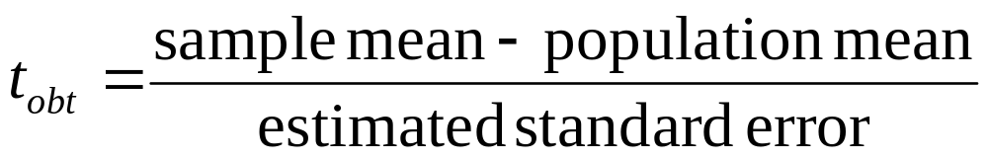
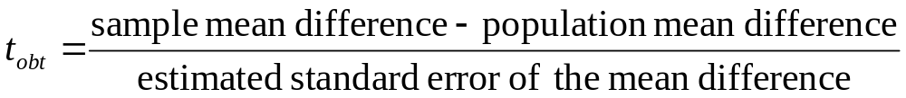
t-Tests Formulas
Single-Sample t-Test
Dependent-Samples t-Test
Notes:
Here are the same formulas described in words instead of symbols.

Slide 14

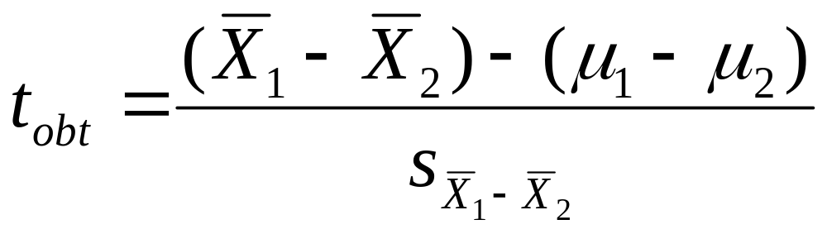
Definitional Formulas
Single-Sample t-Test
Independent-Samples t-Test
Notes:
In each of the t-score formulas, the standard error in the denominator tells us how much discrepancy is reasonable to expect between the two groups being compared if the treatment doesn’t have any effect
In the single-sample t formula, the standard error measures the amount of error expected for a sample mean, in other words, how much difference should be expected between the sample mean and the population mean if the treatment doesn’t have any effect.
In the independent-samples t formula, the standard error measures the amount of difference that is expected between the sample means (mean 1 – mean 2) when the treatment doesn’t have any effect.

Slide 15
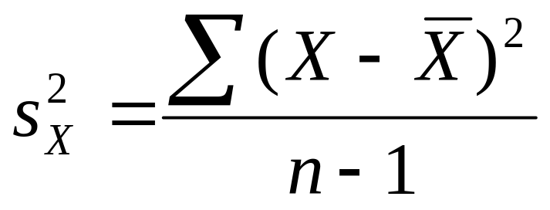
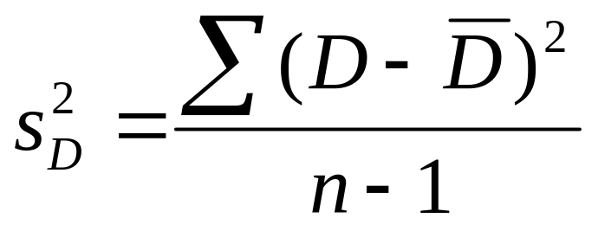
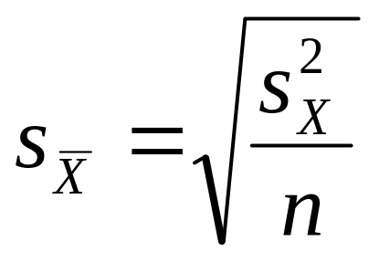
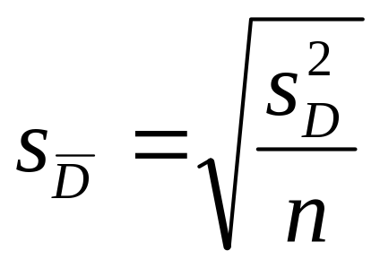

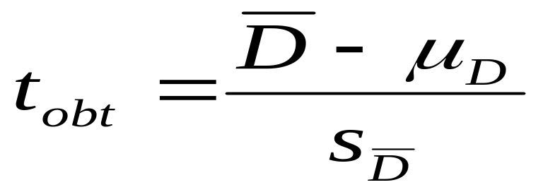
Single-Sample Dependent-Samples t-Test t-Test
Step 1:
Step 2:
Step 3:
Notes:
The formulas to compute the dependent samples t test look an awful lot like those for the single-sample t test.
In the place of raw scores, though, you find difference scores.
Single-Sample t-test:
Step 1 ➔ calculate the estimated variance of the population
Step 2 ➔ calculate the estimated standard error of the mean
Step 3 ➔ calculate t
Dependent-Samples t-test:
Step 1 ➔ calculate the estimated variance of the population of difference scores
Step 2 ➔ calculate the estimated standard error of the mean difference
Step 3 ➔ calculate t

Slide 16
Dependent-Samples t-Test
Calculate the estimated variance of the population of difference scores
Step 1:
Step 2:
Calculate the estimated standard error of the mean difference
Step 3:
Calculate t-obtained
Notes:
Here’s what you just saw for the 3 steps for calculating the dependent-samples t, just by itself and annotated to show what each step does.
Here is what you just saw for the 3 steps for calculating the dependent-samples t, with annotations to indicate what is being done in each step.

Slide 17
Hypothesis Testing
1. State the hypotheses.
2. Set the significance level ➔ α = .05. Determine t_{crit}.
3. Select and compute the appropriate statistic.
4. Make a decision.
5. Report the statistical results.
6. Write a conclusion.
Notes:
If the assumptions are met, then we proceed with testing our hypotheses just like we did before

Slide 18
Hypothesis Testing with Dependent Samples

Slide 19
An Example
Research Question: Which reinforcement schedule elicits more correct responses from pigeons?
A total of 16 pigeons from 8 clutches (2 pigeons from each clutch)
From each clutch, 1 pigeon is assigned to reinforcement schedule A and 1 is assigned to schedule B
Notes:
Match on clutch
Assume that pigeons from the same clutch are more alike than any two random pigeons (treat them like fraternal twins)

Slide 20
Step 1. State the hypotheses.
A. Is it a one-tailed or two-tailed test?
Two-tailed
B. Research hypotheses
Alternative hypothesis:
  Pigeons in Condition A will differ in the number of correct responses from pigeons in Condition B.
Null hypothesis:
  Pigeons in Condition A will not differ in the number of correct responses from pigeons in Condition B.
C. Statistical hypotheses:
H_{A}: μ_{D} ≠ 0
H₀: μ_{D} = 0
Notes:
The alternative hypothesis implies that there is NOT a difference of zero in the population means of the two groups; i.e., the difference between the two groups tends to be positive or tends to be negative, more often than not, so that the positive differences and the negative differences DON’T balance each other out.
The null hypothesis implies that there is a difference of zero in the population means of the two groups; some pairs will have positive differences and others negative differences, but the positives and negatives will balance each other out and end up close to zero.

Slide 21
Step 2. Set the significance level ➔ α = .05. Determine t_{crit}.
Factors That Must Be Known to Find t_{crit}
1. Is it a one-tailed or a two-tailed test?
two-tailed
2. What is the alpha level?
.05
3. What are the degrees of freedom?
df = ?

Slide 22
Degrees of Freedom
Single-Sample
t-Test
Dependent-Samples
t-Test
df = n – 1
n = # of scores
df = n – 1
n = # of pairs
Notes:
The degrees of freedom is much lower in the dependent-samples t test (compared to the independent-samples t test) because N is not the number of scores, but the number of pairs.
There is one set of scores (the difference scores) whose mean is being calculated (D-bar), and that is why you lose only one degree of freedom. When your samples were independent, you calculated the mean of each of two groups, and you lost one degree of freedom for each of those two means.

Slide 23
Degrees of Freedom
Dependent-Samples t-Test
Example:
df = n – 1
= 8 – 1
= 7
Notes:
In our example, there were 8 pairs of pigeons, one pair from each of 8 clutches.

Slide 24

Step 3. Select and compute the appropriate statistic.
Dependent-Samples t-Test
Calculate the estimated variance of the population.
Step 1:
Step 2:
Calculate the estimated standard error of the mean difference
Step 3:
Calculate t-obtained

Slide 25
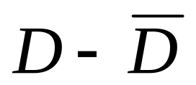
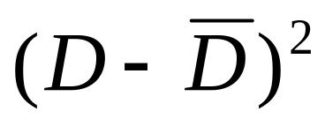



Schedule A | Schedule B | D
6 | 4
8 | 6
5 | 2
7 | 6
5 | 3
7 | 6
5 | 6
7 | 7
ΣX = | ΣX =
= | = | =

Slide 26
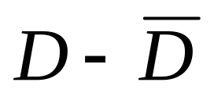

Schedule A | Schedule B | D
6 | 4 | 2 | .75 | .5625
8 | 6 | 2 | .75 | .5625
5 | 2 | 3 | 1.75 | 3.0625
7 | 6 | 1 | -.25 | .0625
5 | 3 | 2 | .75 | .5625
7 | 6 | 1 | -.25 | .0625
5 | 6 | -1 | -2.25 | 5.0625
7 | 7 | 0 | -1.25 | 1.5625
ΣX = 50 | ΣX = 40
= 6.25 | = 5 | = 1.25
Notes:
Notice here that you sum the values in each column.
In the first three columns (those in which you have raw scores and the one in which you calculated the difference score, you also calculate the mean score for the column.
D-bar is the mean difference score, calculated by taking the sum of the difference scores and dividing by the number of difference scores (which is the same as the number of pairs, n).

Slide 27



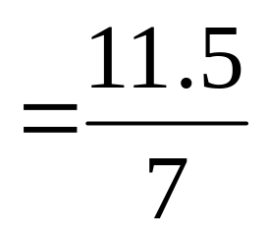
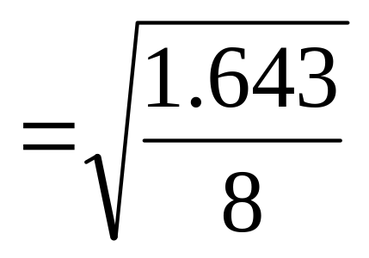
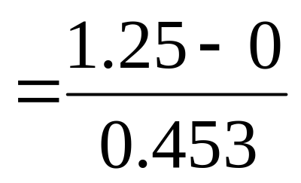

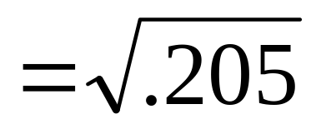
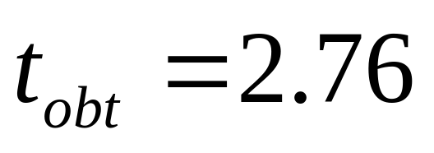
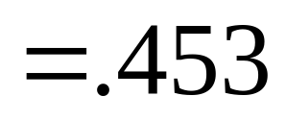

Slide 28
Step 4. Make a decision.
Determine whether the value of the test statistic is in the critical region. Draw a picture.
t_{crit} = ???
t_{crit} = ???
Notes:
What is the critical value for t in this study?
Alpha = .05
Two-tailed
df = 8 pairs – 1 = 7

Slide 29
Step 4. Make a decision.
Determine whether the value of the test statistic is in the critical region. Draw a picture.
Decision? +t_{obt} > +t_{crit} ➔ Reject Ho
t_{crit} = -2.365
t_{crit} = +2.365
t_{obt} = 2.76
Notes:
So t-crit = +/- 2.365
And because t-obtained is greater than the positive value for t-crit, we reject the null hypothesis.

Slide 30
Step 5. Report the statistical results.
t(7) = 2.76, p < .05
Does this indicate that you retain or reject the null hypothesis?
What does it mean to say that p < .05?

Slide 31
Step 6: Write a conclusion.
State the relationship between the IV and the DV in words:
Pigeons in Condition A (M = 6.25) made significantly more correct responses than pigeons in Condition B (M = 5), t(7) = 2.76, p < .05.

Slide 32
Step 6: Write a conclusion.
State the relationship between the IV and the DV in words:
Schedule A resulted in an average of M = 1.25 more correct responses than schedule B. There was a significant difference in performance between the two schedules, t(7) = 2.76, p < .05.
Notes:
Another way to state it.

Slide 33
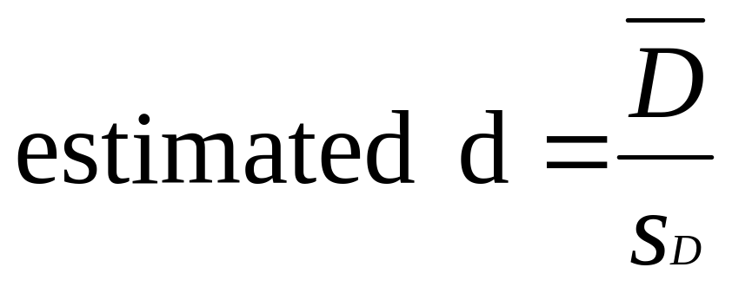
Step 7. Compute the estimated d.
Notes:
Just like we did for the one-sample t test, we can calculate Cohen’s estimated d.
Note that the denominator is the estimated standard deviation of the difference scores. You can calculate that by taking the square root of the estimated variance of the difference scores, which you calculated earlier.

Slide 34
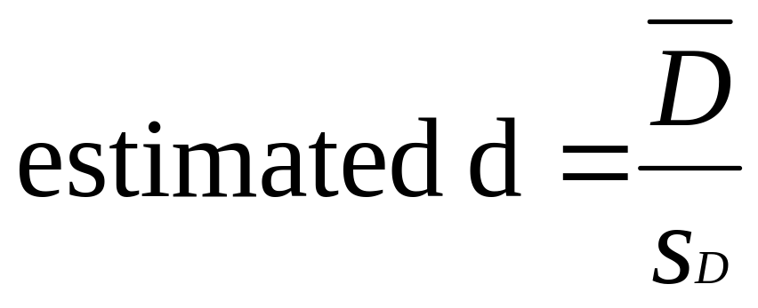
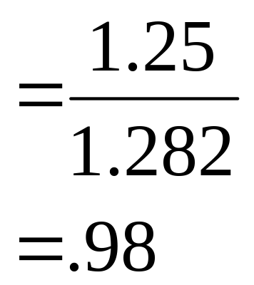
Step 7. Compute the estimated d.
Notes:
This result indicates that there was almost a 1 SD difference in the performance of the two groups.

Slide 35
Effect Size
d Effect Size
0.2 Small effect
0.5 Medium effect
0.8 Large effect
Notes:
To remind you, here is what the different effect sizes indicate about the treatment
d = 0.2 ➔ mean difference around .2 SD
d = 0.5 ➔ mean difference around .5 SD
d = 0.8 ➔ mean difference around .8 SD

Slide 36
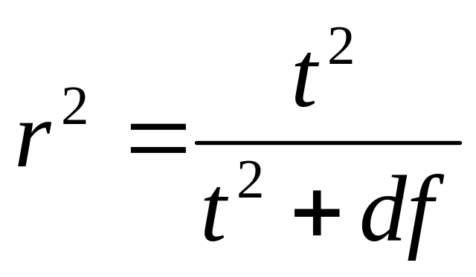
Step 8. Compute r² and write a conclusion.

Slide 37
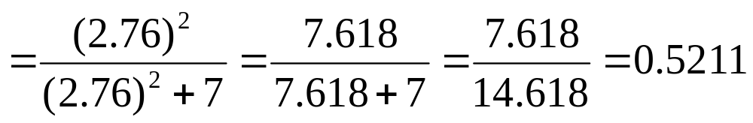
Step 8. Compute r² and write a conclusion.

Slide 38
Step 8. Compute r² and write a conclusion.
The reinforcement schedule can account for 52.11% of the variance in the difference in number of correct responses between the two conditions.
Simpler:
The reinforcement schedule can account for 52.11% of the variance in the difference scores.

Slide 39
Percentage of Variance Explained (r²)
r² Percentage of Variance Explained
0.01 Small effect
0.09 Medium effect
0.25 Large effect
Notes:
Here is the way the r-squared scores are typically interpreted.

